Slide 1

PYTHON DATA ANALYSIS PORTFOLIO
E-Commerce Sales Analytics
Exploratory Data Analysis, Data Preprocessing & Feature Engineering on 5,000 Retail Orders
Pandas & NumPy
Matplotlib & Seaborn
Visualizations
Customer Insights
Dataset: 5,000 Transactions
Source: Kaggle Dataset

Slide 2
EXECUTIVE OVERVIEW
Project Scope & Dataset Highlights
Comprehensive Analysis Scope
End-to-end evaluation of e-commerce order patterns, revenue distribution, delivery logistics, and customer ratings across major product categories.
5,000 Total Orders Analyzed
$1,022 Average Order Value
Key Deliverables
4 Product Categories
21 Final Analysis Features
Automated preprocessing pipeline, 9 new engineered business metrics, and exploratory visualizations for strategic optimization.

Slide 3

DATA PIPELINE
Data Preprocessing & Integrity Workflow
1
2
3
4
Date Standardizing
Missing Imputation
Deduplication Check
Type Validation
Converted order dates to datetime formats via pandas parsing.
Applied median for numeric metrics and mode for categoricals.
Verified zero duplicate records across 5,000 unique rows.
Ensured clean numeric float64 and integer schema consistency.

Slide 4
FEATURE ENGINEERING
Derived Features for Business Intelligence
Gross & Discount
Unit Economics
Delivery Bins
Rating Groups
Calculated pre-discount gross sales and absolute discount value.
Net revenue earned per individual unit sold.
Categorized delivery speed into Fast, Normal, and Slow tiers.
Segmented customer feedback into 4 quality tiers.
gross = qty * price
rev_per_unit = rev / qty
pd.cut(delivery_days)
Poor → Excellent

Slide 5
SALES DISTRIBUTION
Product Category & Regional Performance
Category Breakdown
Geographic Share
Electronics
$1.42M
West Region 26.4%
South Region 25.1%
Beauty
$1.28M
Clothing
$1.21M
East Region 24.8%
North Region 23.7%
Home
$1.19M

Slide 6
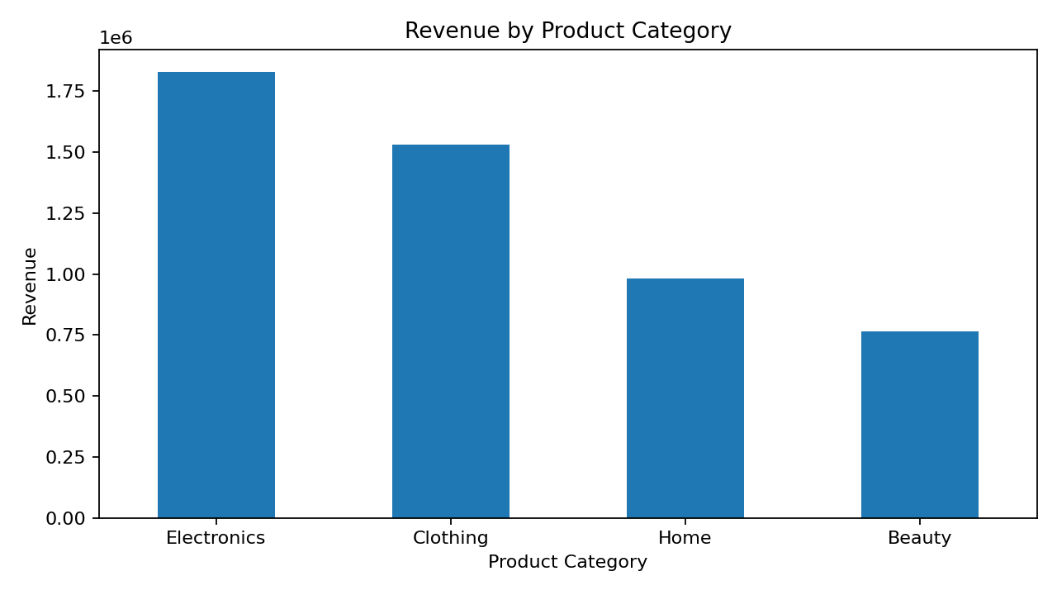
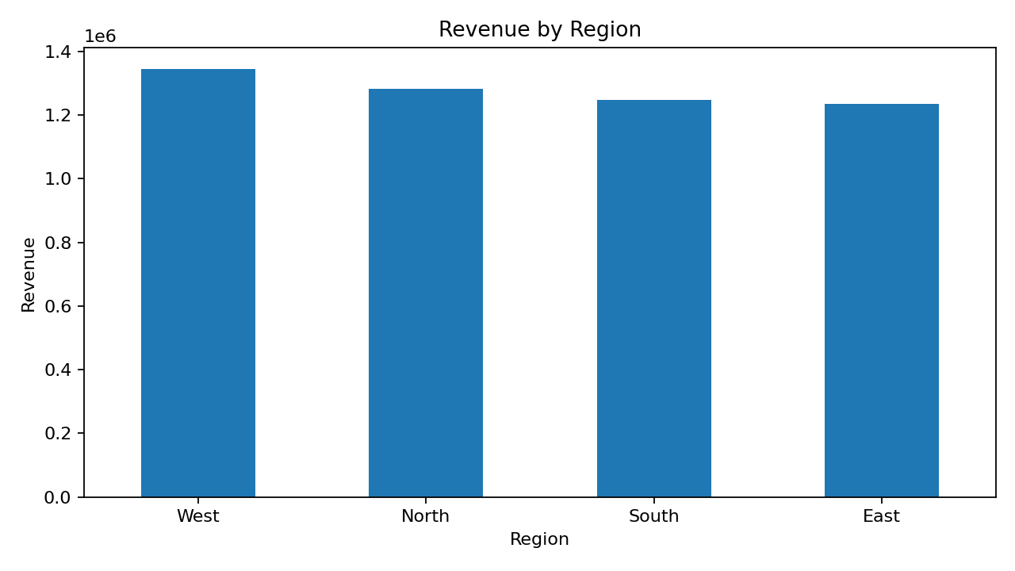
Revenue by Product Category
Highest revenue category: Electronics.
Revenue from Electronics: 1,829,899.22.
Category comparison helps identify where sales value is concentrated.
Revenue by Region
Highest revenue region: West.
Regional analysis shows where sales performance is strongest.
This can support regional marketing and sales decisions.

Slide 7
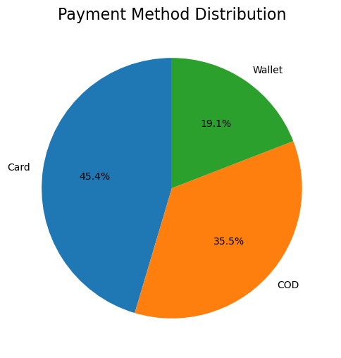
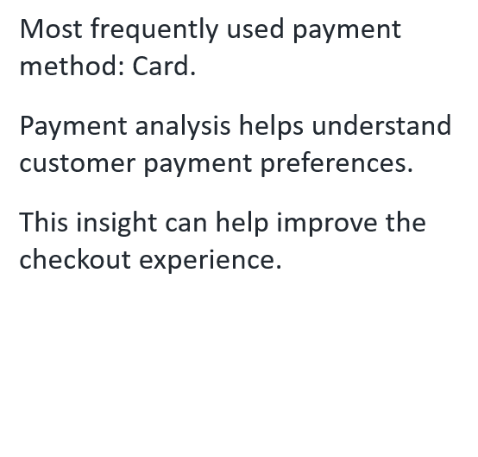
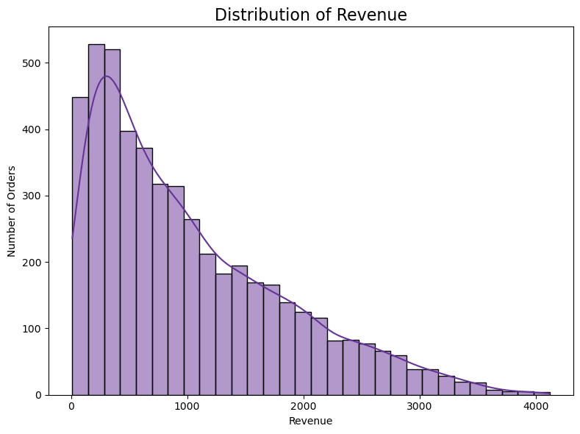
Payment Method Analysis
Distribution of Revenue
Support statistical analysis of revenue
Understand the distribution of order revenue
Determine whether revenue is normally distributed or skewed
Identify possible very low or very high revenue values

Slide 8
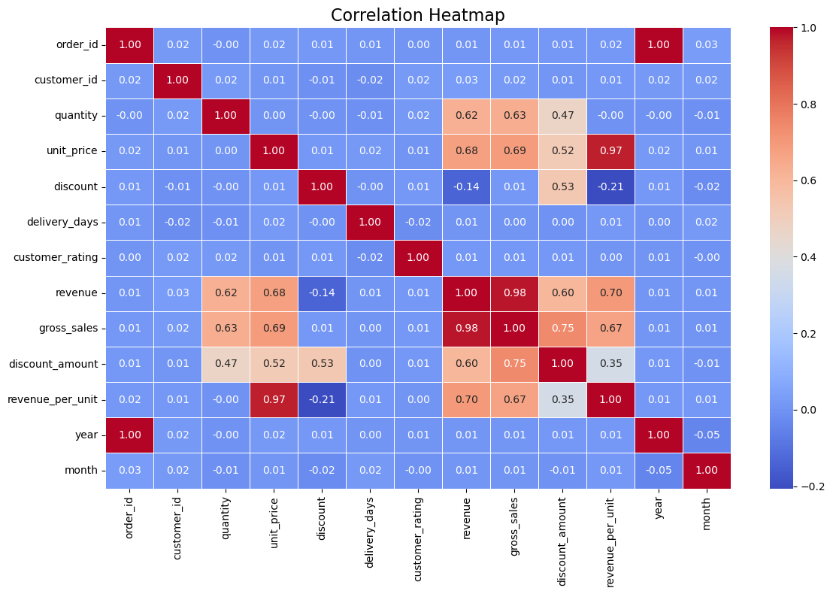
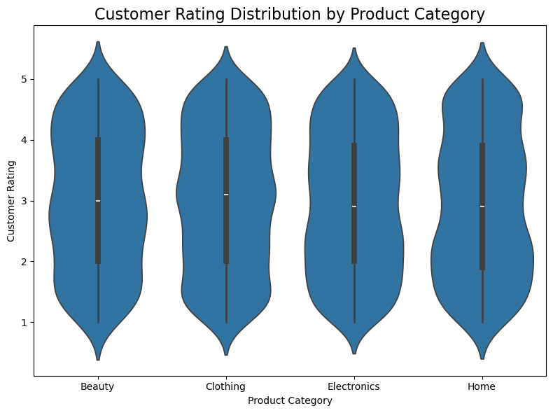
Correlation Heatmap
Identify relationships between numerical variables.
Find variables that are strongly positively or negatively correlated.
Detect variables with weak relationships.
Support your statistical and business analysis.
Customer Rating Distribution by Product Category
Compare customer satisfaction across product categories.
Identify categories with ratings concentrated around high or low values.
Observe how much variation exists in customer ratings.

Slide 9
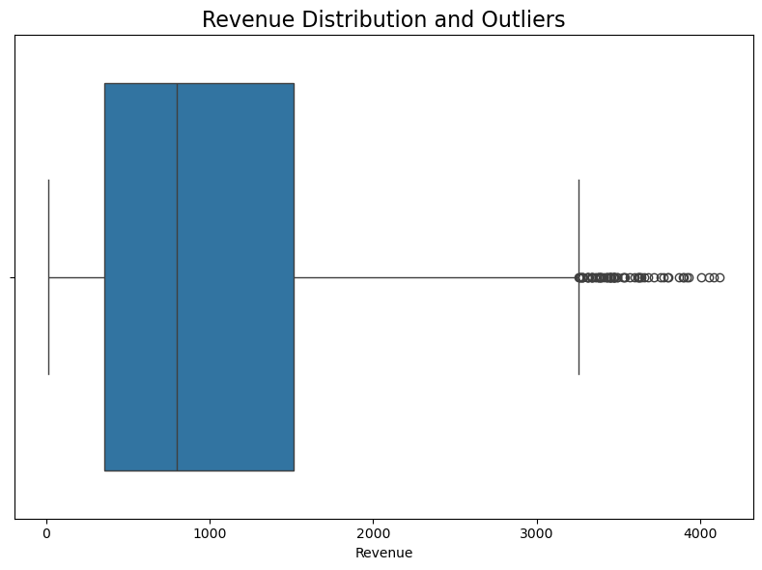
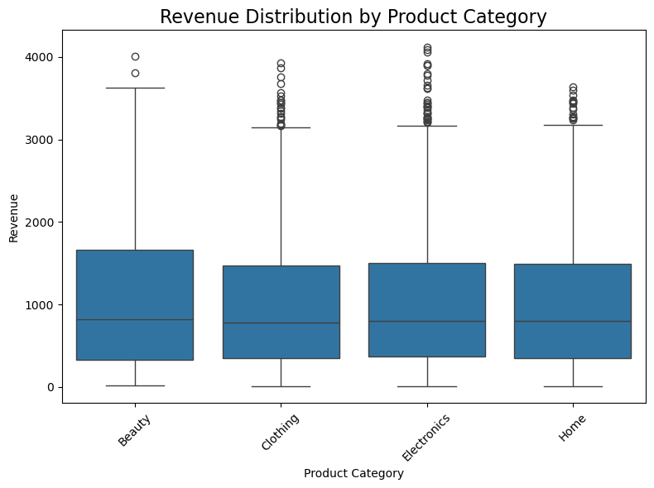
Revenue Distribution and Outliers
Understand the spread of order revenue
Identify the median revenue
Check whether the dataset contains outliers
Understand whether a few extreme orders may affect the average revenue
Revenue Distribution by Product Category
Compare revenue distributions between categories
Identify categories with higher or lower typical order values
Understand how much revenue varies within each category

Slide 10
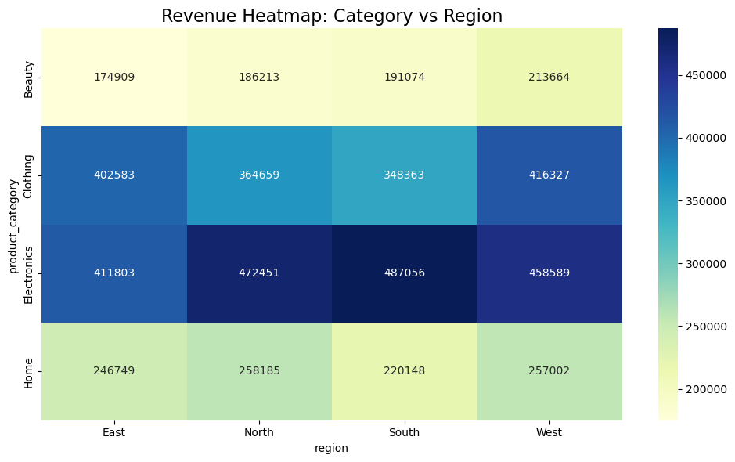
Category vs Region Heatmap
Compare revenue across categories and regions.
Identify the best-performing category in each region.
Find regional differences in product performance.
Quickly identify important category-region combinations.

Slide 11


OPERATIONS & LOGISTICS
Delivery Cycle & Payment Preferences
6.1 Days Avg Delivery
Fulfillment range spans from 1 to 11 days.
Card Payment Dominance
Credit and debit cards represent the highest transaction volume
18.0% Average Discount
Discounts range up to 35% across promo periods.

Slide 12
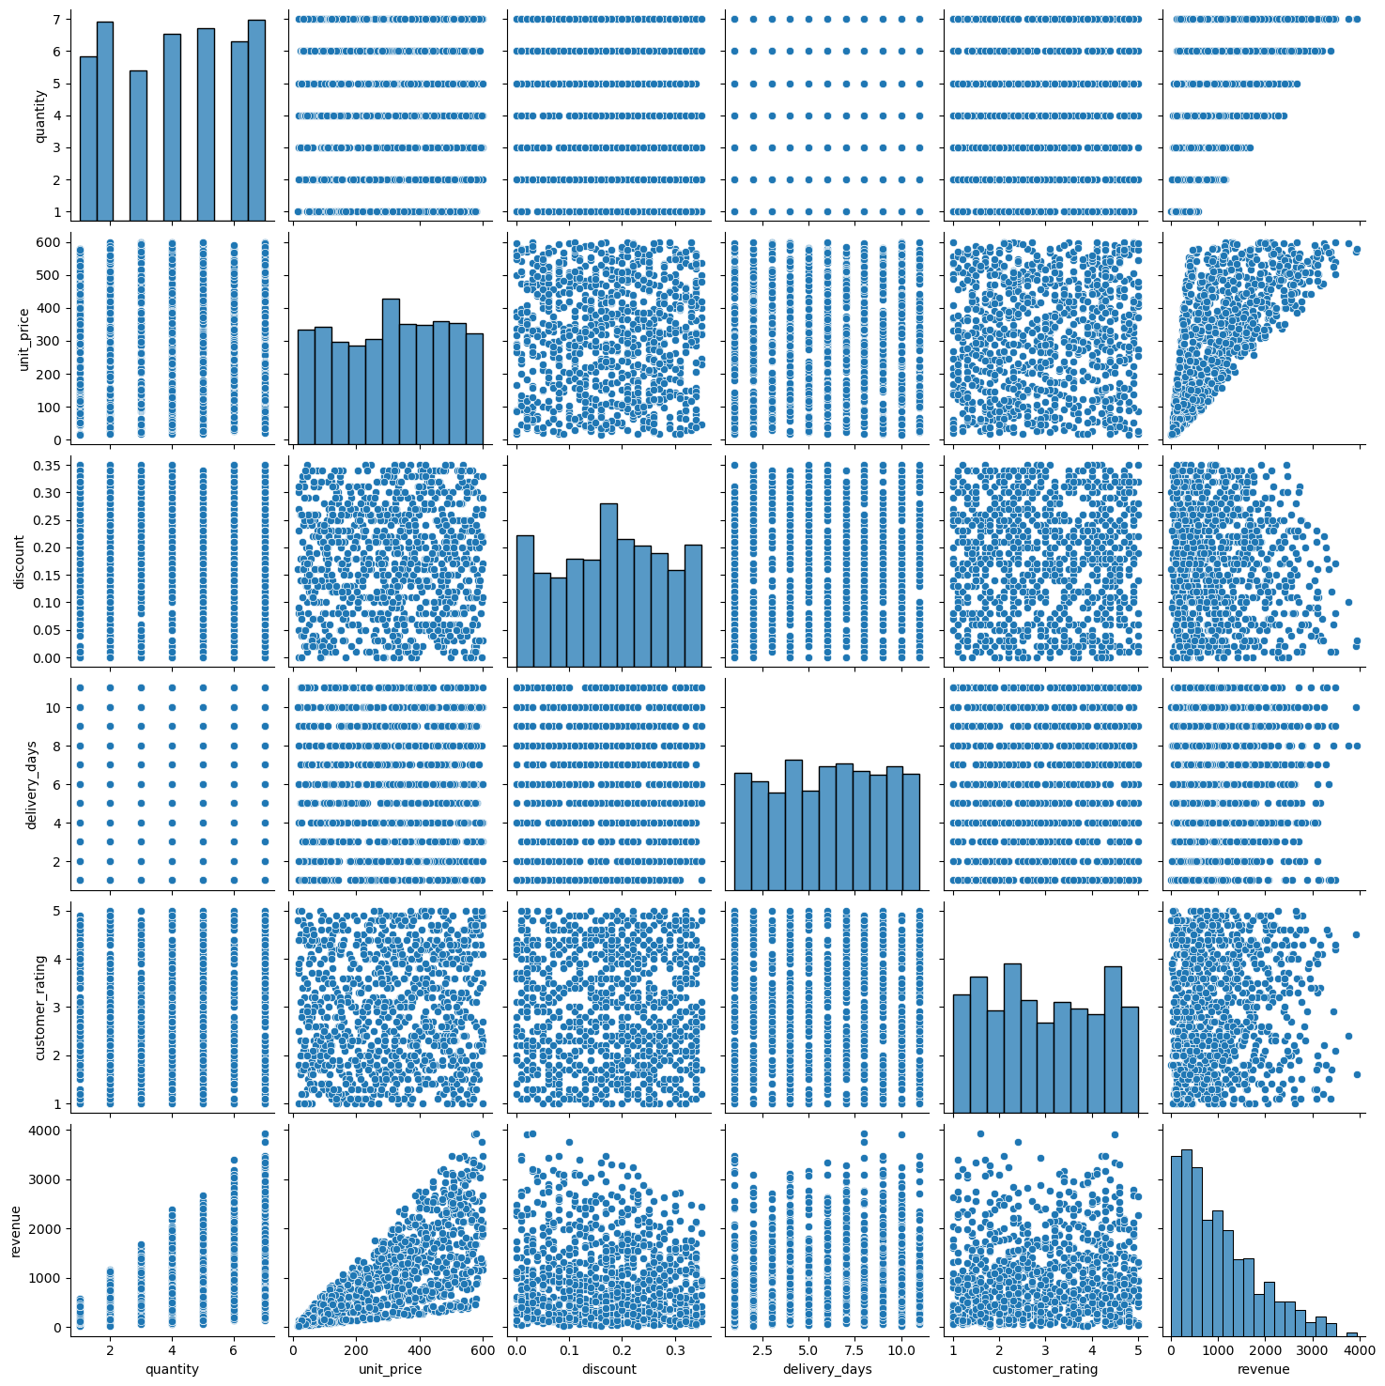
Pair Plot — Relationship Between Numerical Variables
Analyze multiple relationships simultaneously.
Detect unusual observations or outliers.
Understand the individual distribution of each numerical variable.
Identify variables that appear to have a strong relationship.

Slide 13

TECHNICAL STACK
Python Analytics Stack & Workflow
Pandas & NumPy
Matplotlib / Seaborn
Jupyter Environment
Data wrangling, date parsing, vector operations, and feature creation.
Custom statistical visual plots, heatmaps, and distribution graphs.
Interactive notebook execution with embedded visual outputs.

Slide 14

CONCLUSION
Key Insights & Business Value
Electronics Driving Revenue
Optimize Delivery Cycles
Targeted Discounting
Electronics represents top revenue share; prioritize high-tier promos.
Reduce 6.1-day avg shipping time to boost customer satisfaction ratings.
Fine-tune discount rates to preserve net revenue margins.
Thank You!
Questions & Discussion

